Slide 1

World Happiness Report
Presented by:-
Pranav Goel
18csu158

Slide 2
Purpose?
The purpose of choosing this dataset is to find out
which factors are more important to live a happy life.
We will also implement several machine learning
algorithms to predict the happiness Status and
compare the result to discover which algorithm works
better for our dataset.

Slide 3
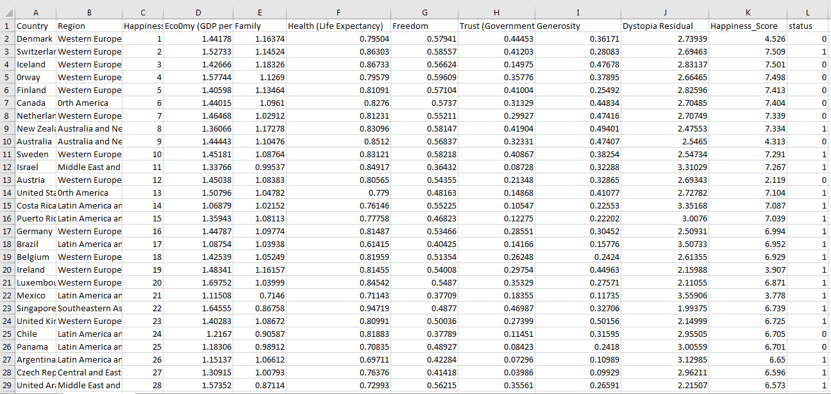
DATASET DESCRIPTION
This dataset consists of 78 happy countries and 79 less happy countries .
The status column is a class label used to divide groups into happy and less happy countries.

Slide 4

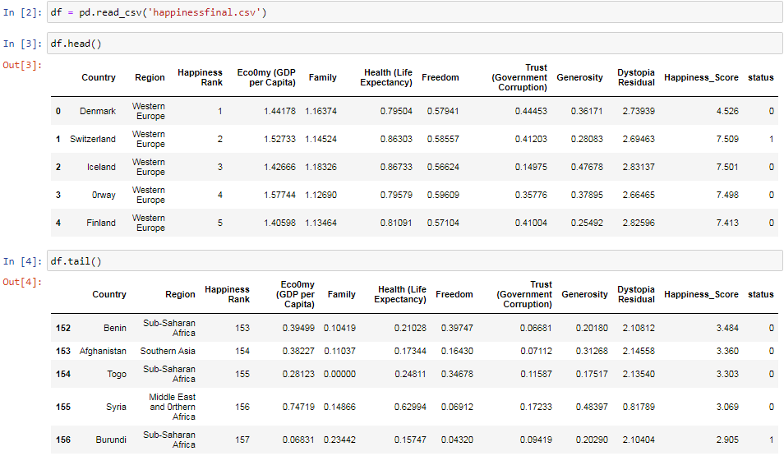
Import libraries
Import Dataset
Head and Tail function is used to display first and last 5 rows of dataset

Slide 5
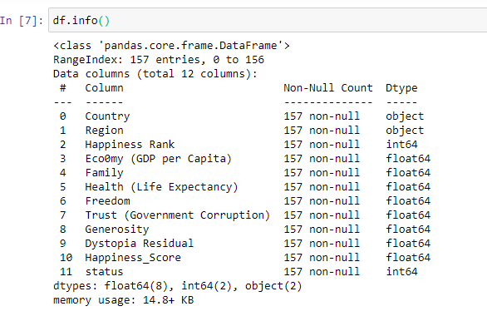
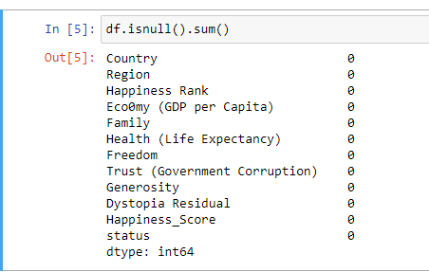
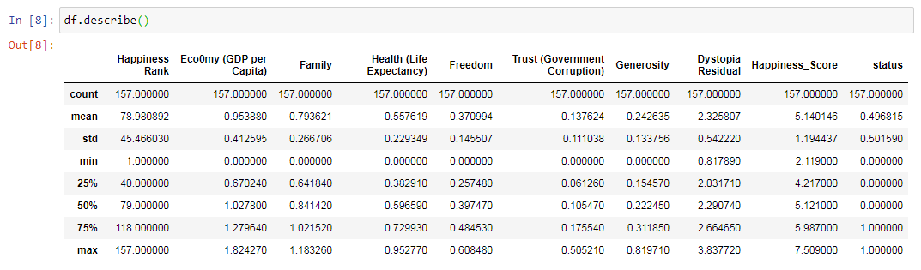
#Summarizing Data
#Checking for null values
#Describing Dataset

Slide 6
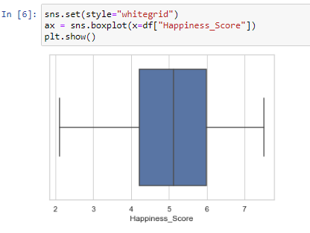
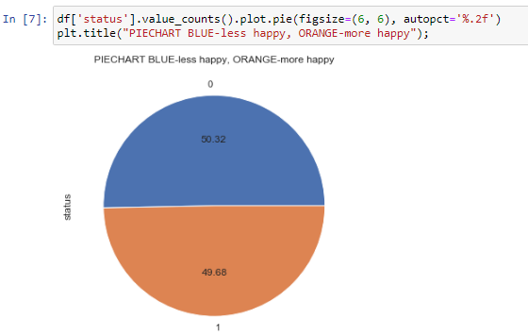
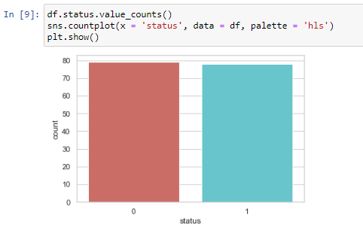
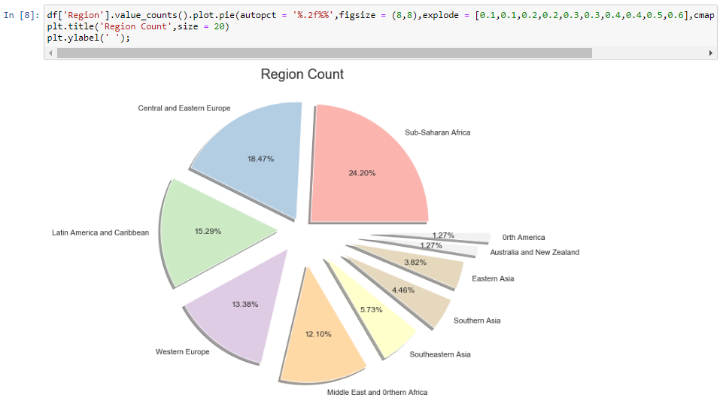
5 Number summary of happiness score
The percentage of Happy and less happy countries are almost same
The count of Happy and less happy countries are almost same
Pie Chart for Regions

Slide 7
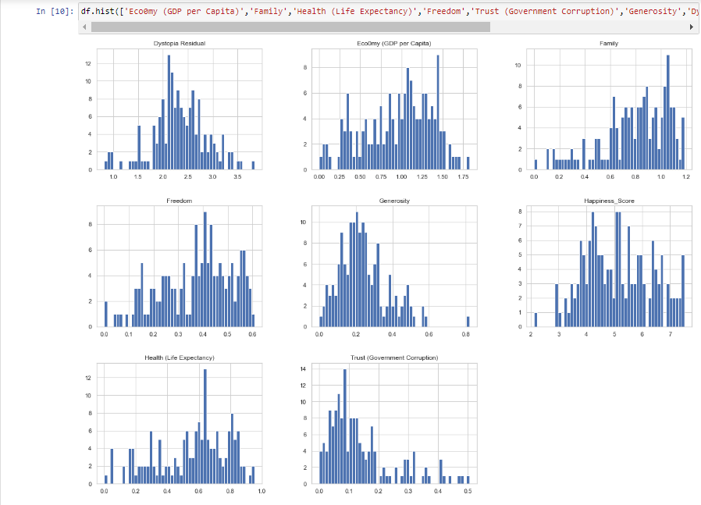
It shows how the values of each attributes are distributed

Slide 8
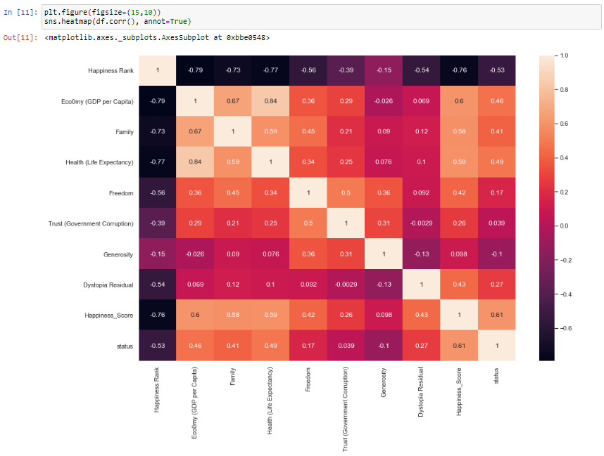
Maximum correlation is between economy and health(0.84)

Slide 9
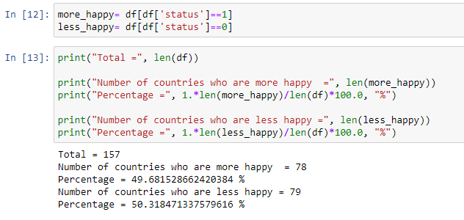
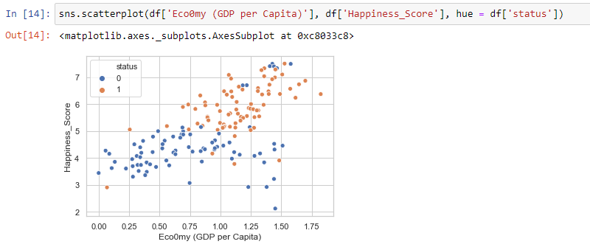
Countries with higher economy(GDP per capita) and happiness score are more happy

Slide 10
Regression Models

Slide 11


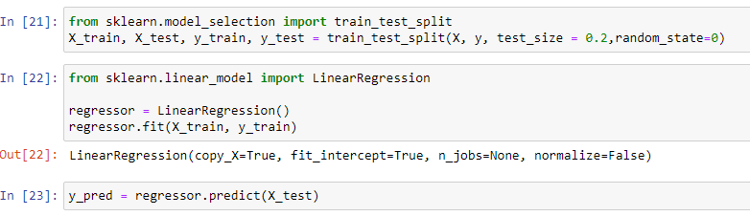
Linear Regression
Linear regression is a machine learning algorithm based on supervised learning that performs the task to predict dependent variable value(happiness score) based on given independent variable(Economy(GDP per capita)).
X variable represents economy per capita
y variable represents Happiness Score
Splitting data into Training and Testing set

Slide 12
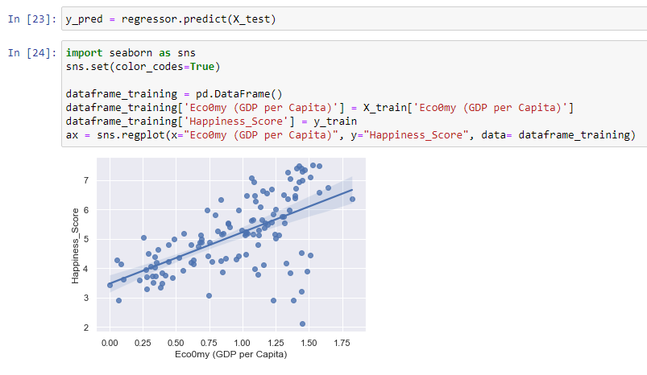
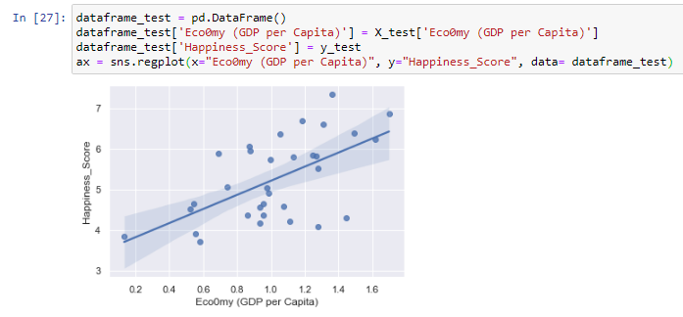
Prediction of happiness score from economy
Graph for Training set showing best fit line
Graph for Testing set showing best fit line

Slide 13
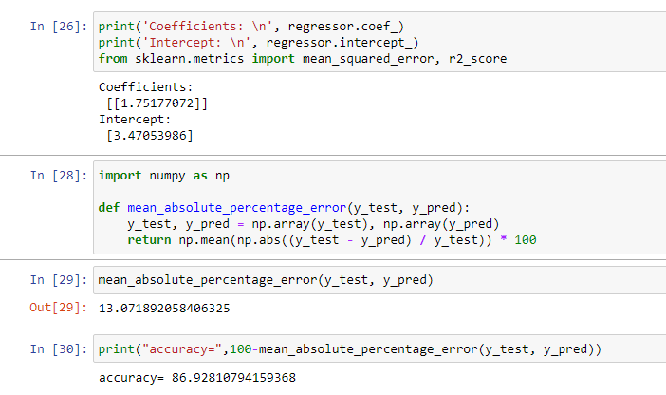
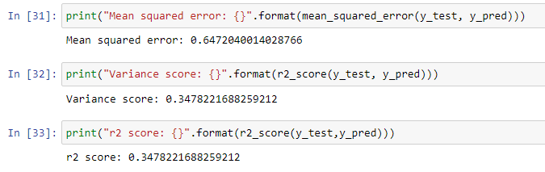
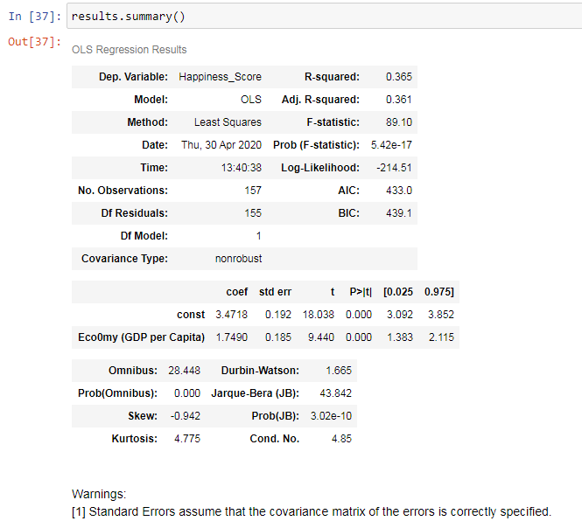
Results
Coefficients , intercept
Mean sq error , variance Score,r^2 value
Summary of linear regression telling us the R squared value , Adj. R-squared value , etc

Slide 14
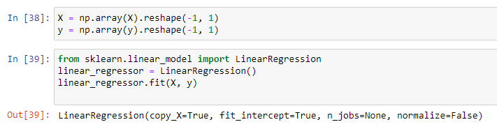
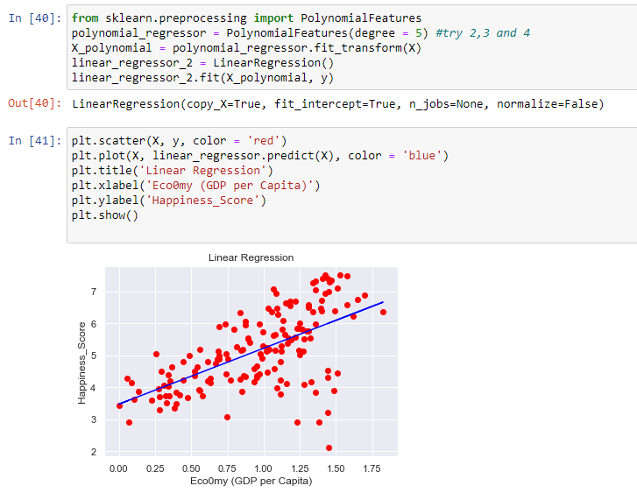
Polynomial Regression
Fitting Linear regression to the dataset
Fitting Polynomial Regression to the dataset
Graph of linear Regression showing us the best fit line

Slide 15
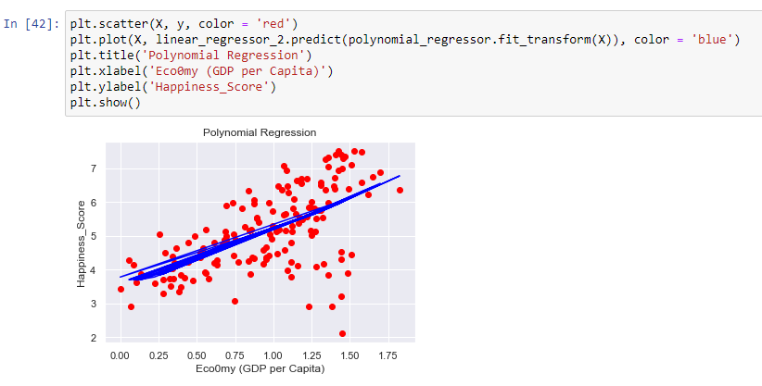
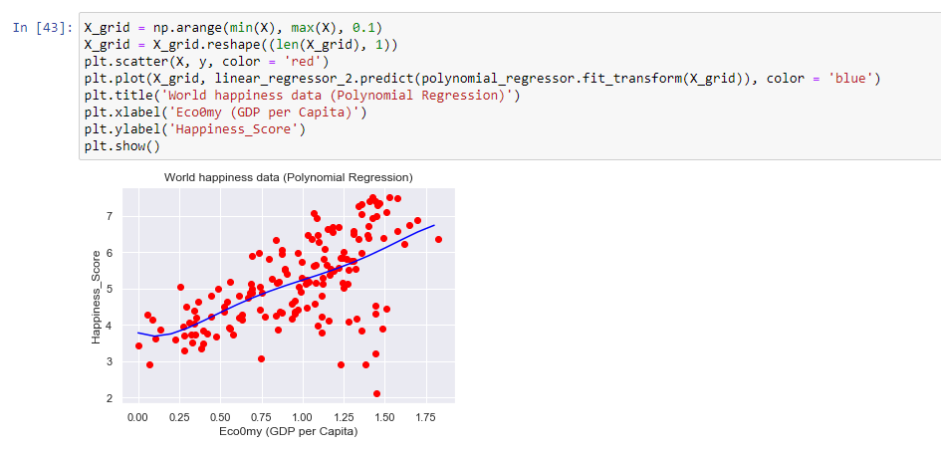
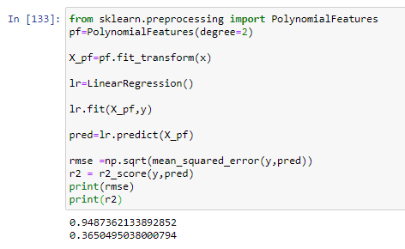
Graph of Polynomial regression after smoothing is done
Graph of polynomial regression .
rmse and r2 score for polynomial regression

Slide 16
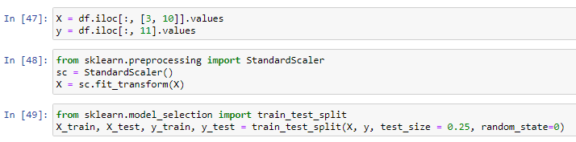
LOGISTIC REGRESSION
Logistic Regression is a supervised Learning classification algorithm used to predict the probability of a target variable
Step1: Storing values of economy and happiness score in X ; value of Status in y
Step2:Feature scaling is done to normalize the data in a particular range
Step3: Splitting dataset in training and testing

Slide 17
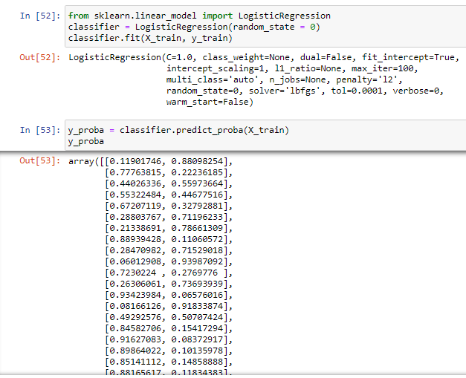
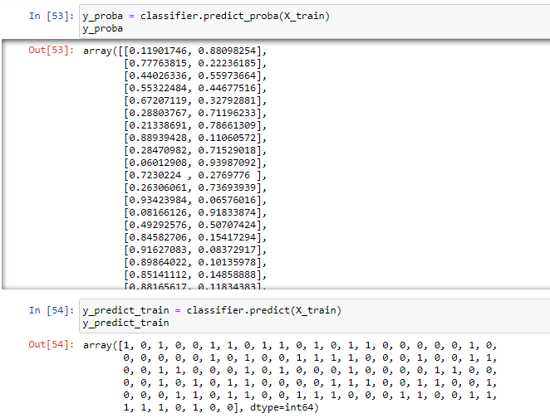
Training our logistic regression model
Values predicted by our model

Slide 18
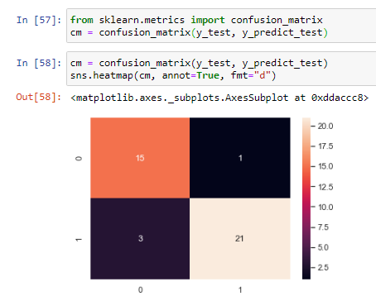
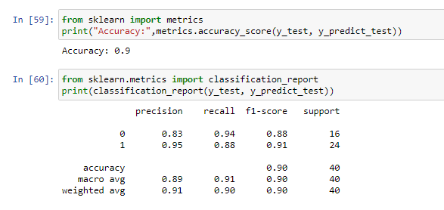
Confusion matrix for testing set
Accuracy and Classification Report
Accuracy of logistic model is 90%

Slide 19
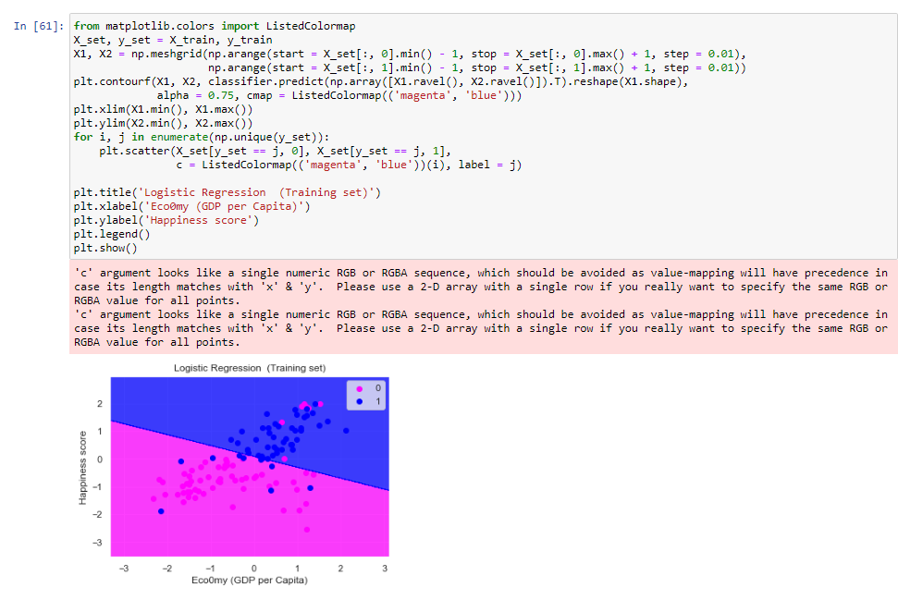
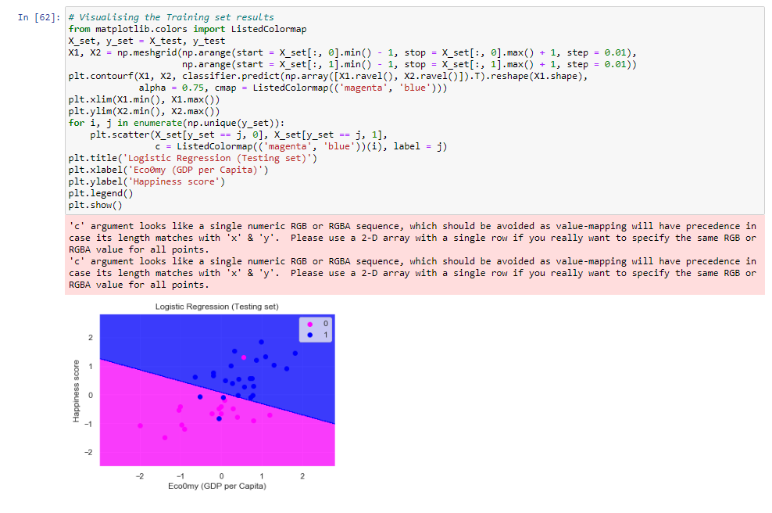
Visualizing training set result
Visualizing testing set results

Slide 20
Classification Models

Slide 21
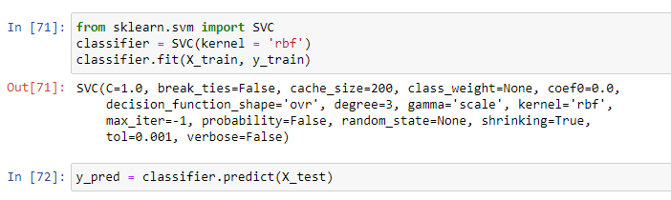
SVM
“Support Vector Machine” (SVM) is a supervised machine learning algorithm which can be used for both classification or regression challenges. However, it is mostly used in classification problems
Fitting Training Set on classifier object of SVM

Slide 22
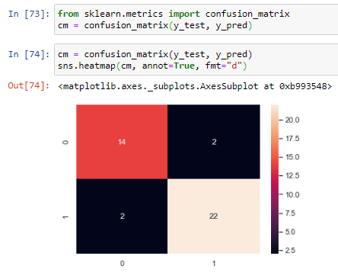
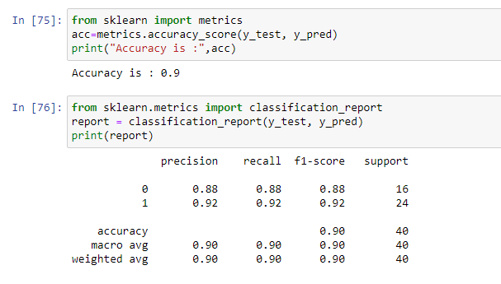
PERFORMANCE MEASURE
Accuracy and classification report
Confusion matrix
Accuracy of SVM is coming out to be 90%.

Slide 23
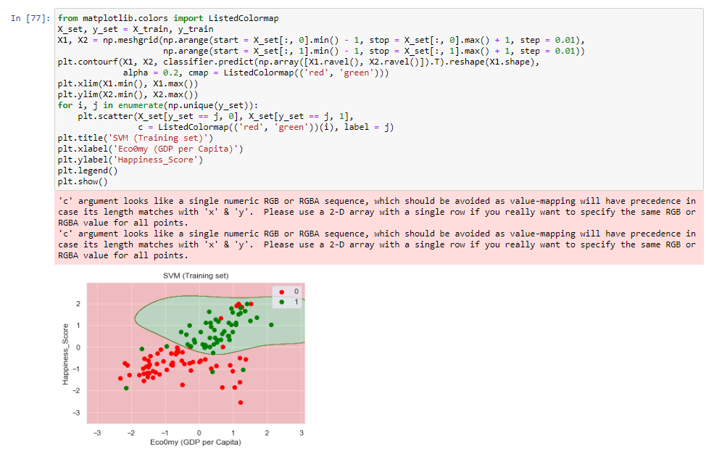
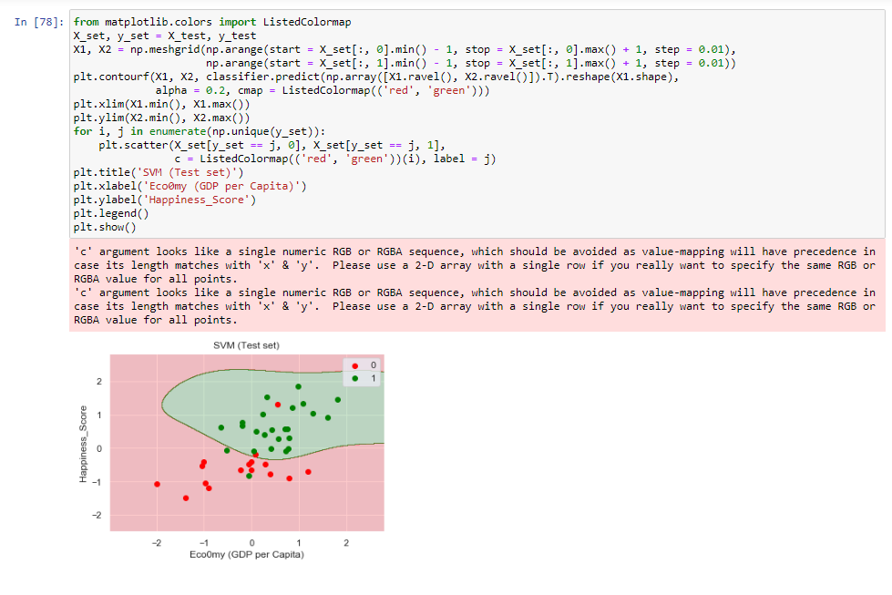
Visualizing training set result
Visualizing testing set result

Slide 24
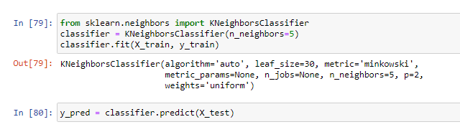
KNN MODEL
K-Nearest Neighbors (KNN) is one of the simplest algorithms used in Machine Learning for regression and classification problem.
Fitting training set on classifier object of KNN

Slide 25
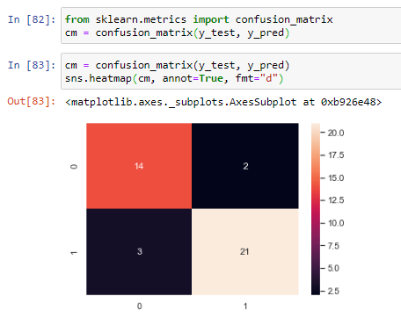
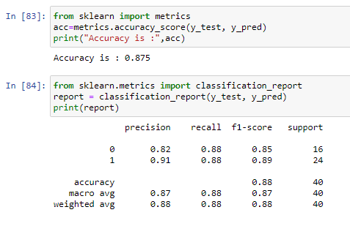
PERFORMANCE MEASURE
Confusion Matrix
Accuracy and classification Report
Accuracy of KNN is 87.5% .

Slide 26
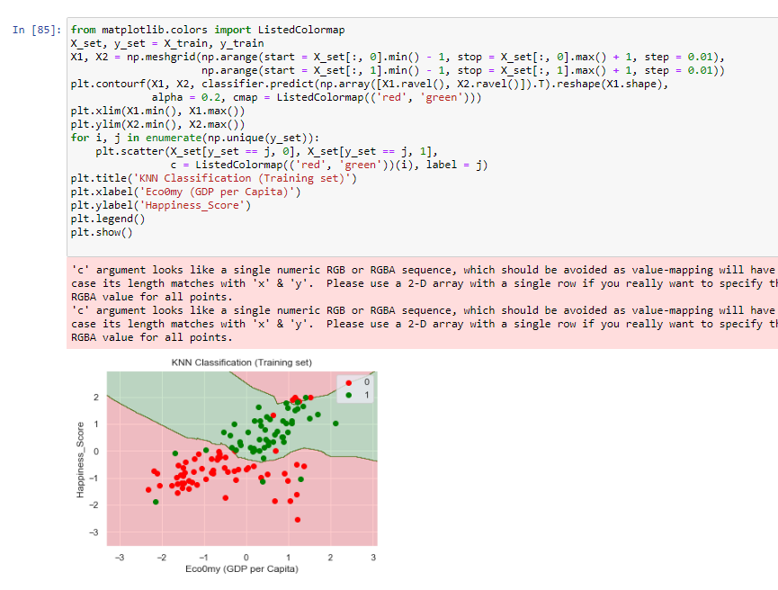
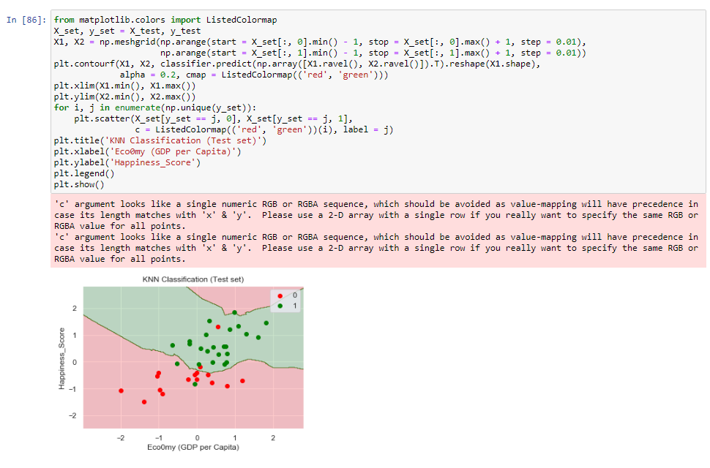
Visualizing Training Set results
Visualizing Testing Set results

Slide 27
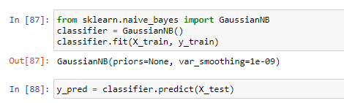
NAIVE BAYES MODEL
NAIVE BAYES Theorem provides a way that we can calculate the probability of a piece of data belonging to a given class , given our prior knowledge.
Fitting training set on classifier object of Naive Bayes

Slide 28
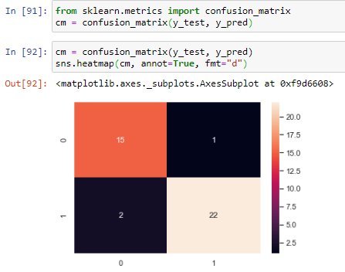
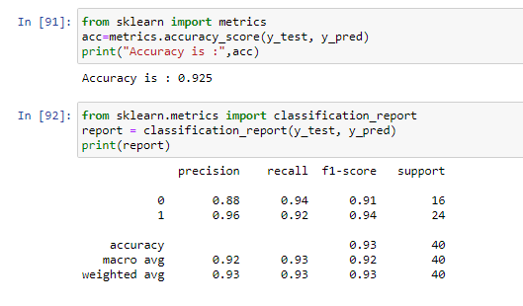
Performance Measure
Confusion Matrix
Accuracy and classification Report
Accuracy of Naive Bayes is 92.5%

Slide 29
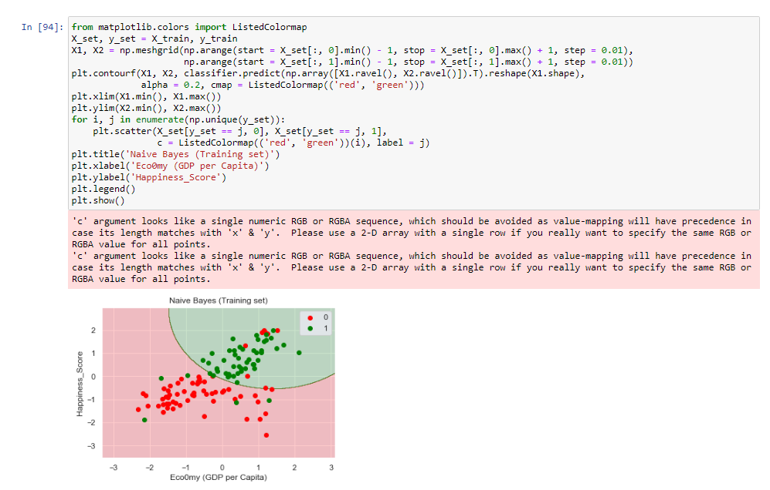
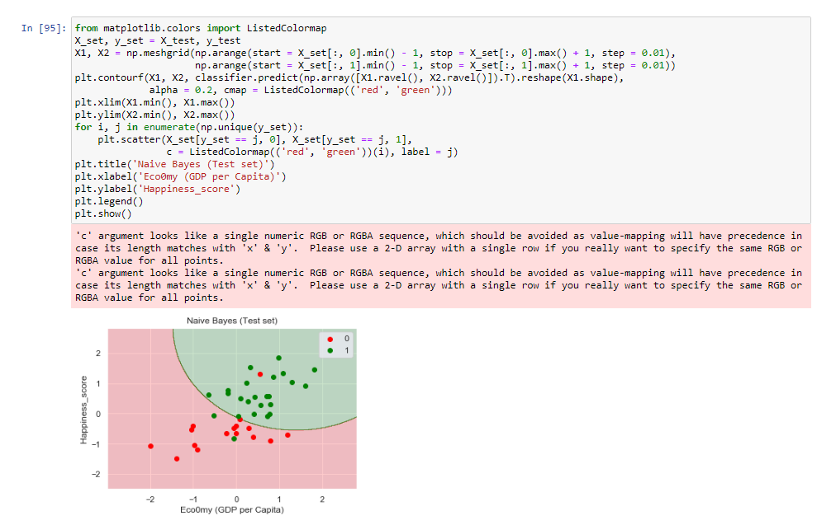
Visualizing Training Set results
Visualizing Testing Set results

Slide 30
Conclusion of classification models:
Accuracy of the model in SVM-90%
Accuracy of the model in KNN-87.5%
Accuracy of the model in Naive Bayes-92.5%
Therefore , Naive Bayes is best classifier for our model
Analysis of classification models:
Accuracy of the model in SVM-90%
Accuracy of the model in KNN-87.5%
Accuracy of the model in Naive Bayes-92.5%
Therefore , Naive Bayes is the best classification model for this dataset

Slide 31
THANK YOU

